Slide 1
Electric Motors 101

Slide 2
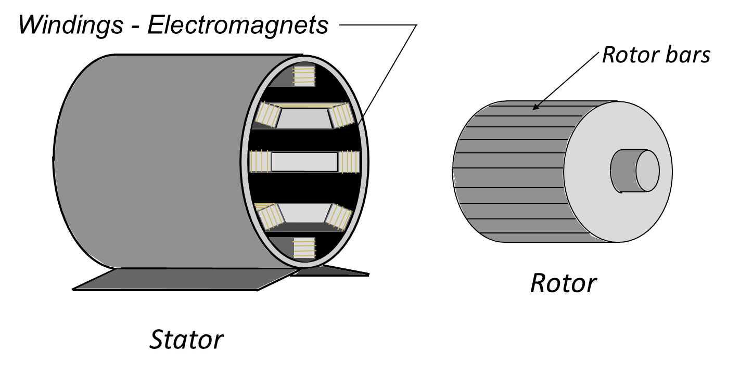
Three Phrase Motor Construction

Slide 3
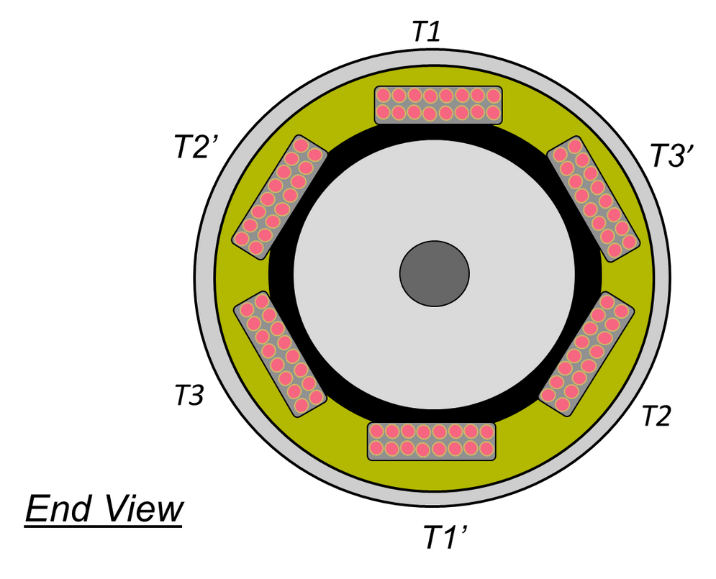
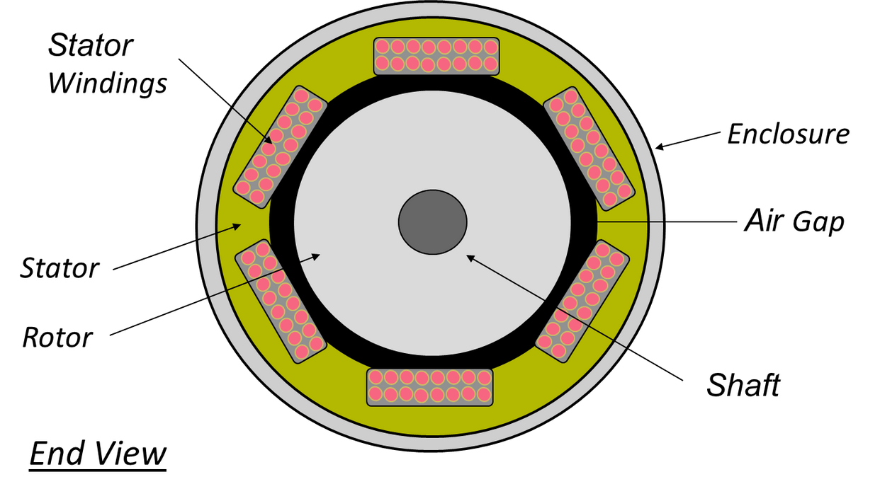
Three Phrase Motor Construction

Slide 4
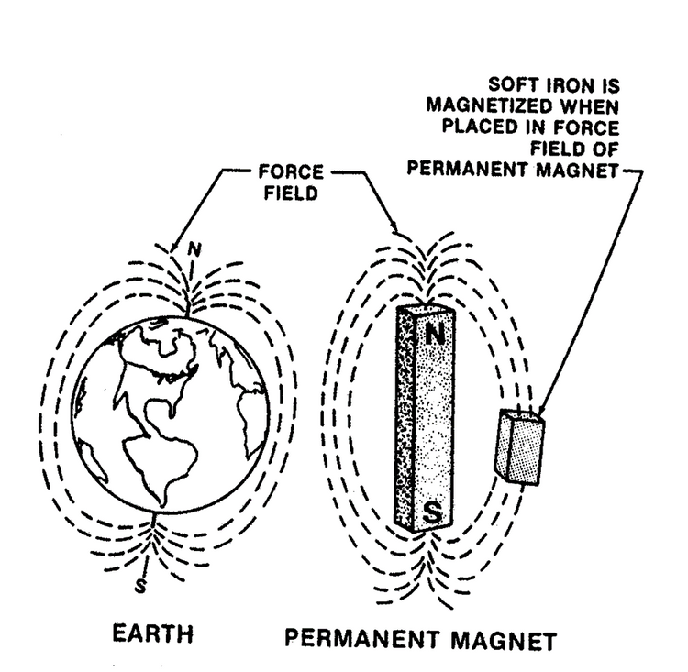
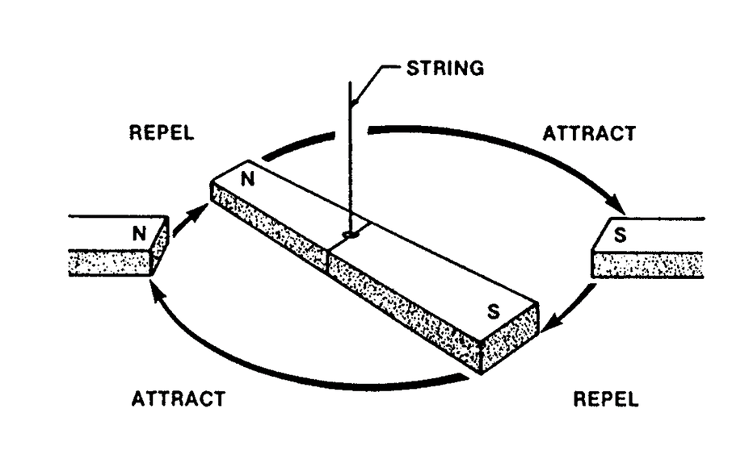
Motor
Operation

Slide 5
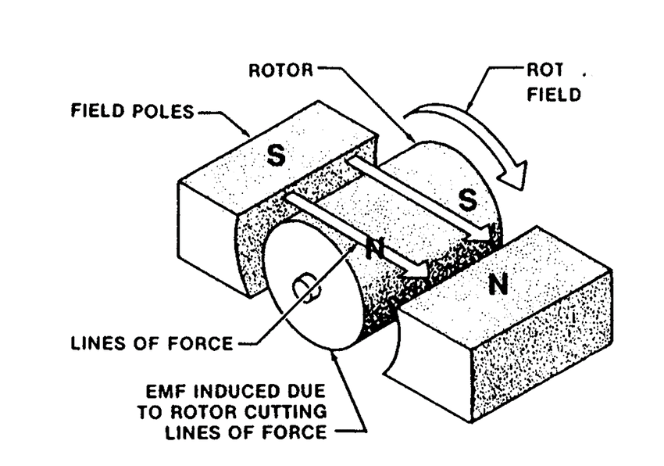
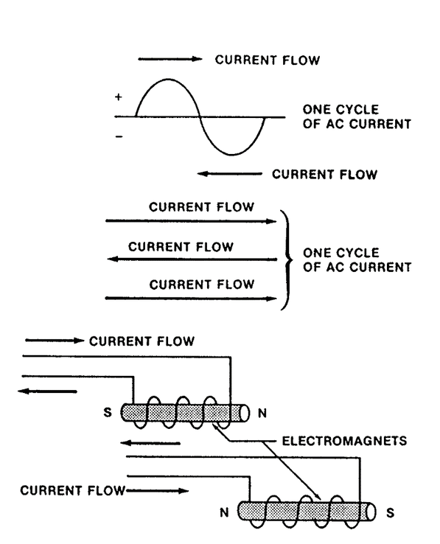
Motor
Operation

Slide 6
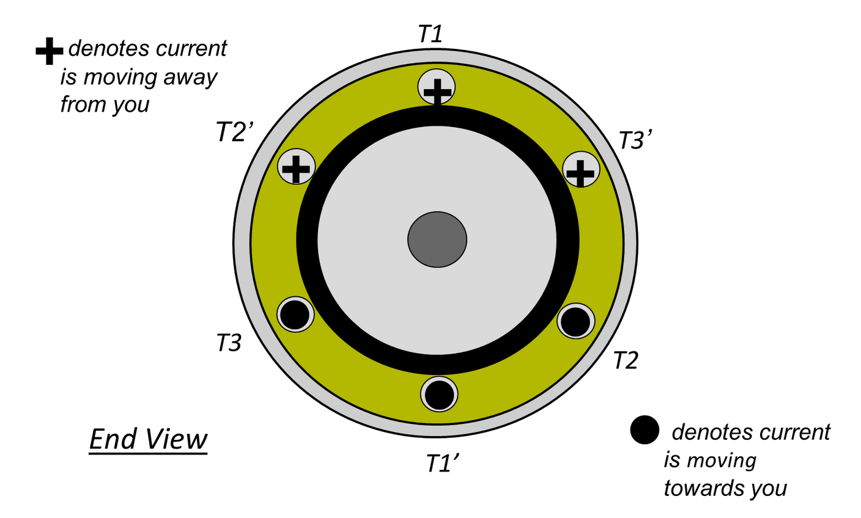
Three Phrase Motor Construction

Slide 7
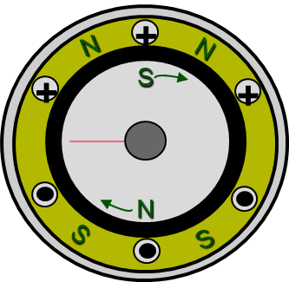
Rotation of the Motor

Slide 8
Rotation of the Motor

Slide 9
Rotation of the Motor

Slide 10
Rotation of the Motor

Slide 11
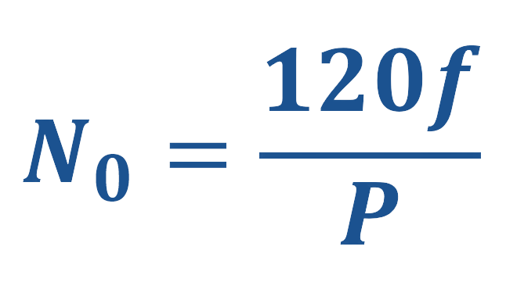
Synchronous Speed of Motor

Slide 12
Magnetic Poles
Synchronous RPM
2
3600
Poles &
Sychronus
RPM @ 60HZ
4
1800
6
1200
8
900
7200/P = Synchronous RPM
7200/Synchronous RPM = P

Slide 13
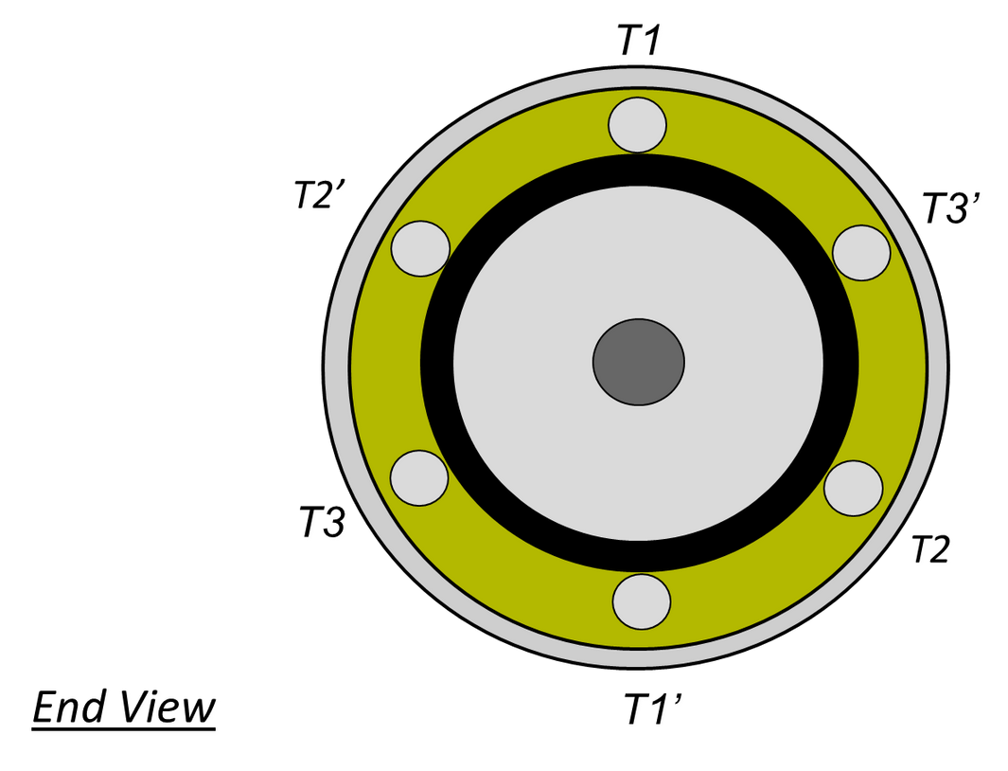
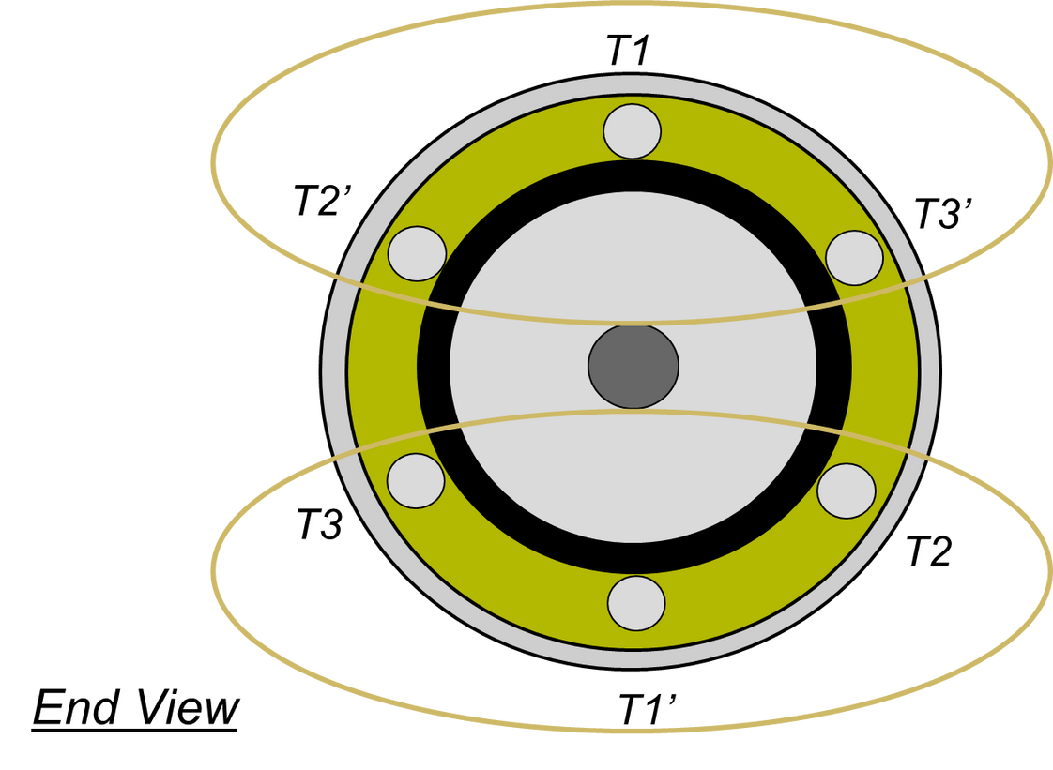
Three Phrase Motor Construction

Slide 14
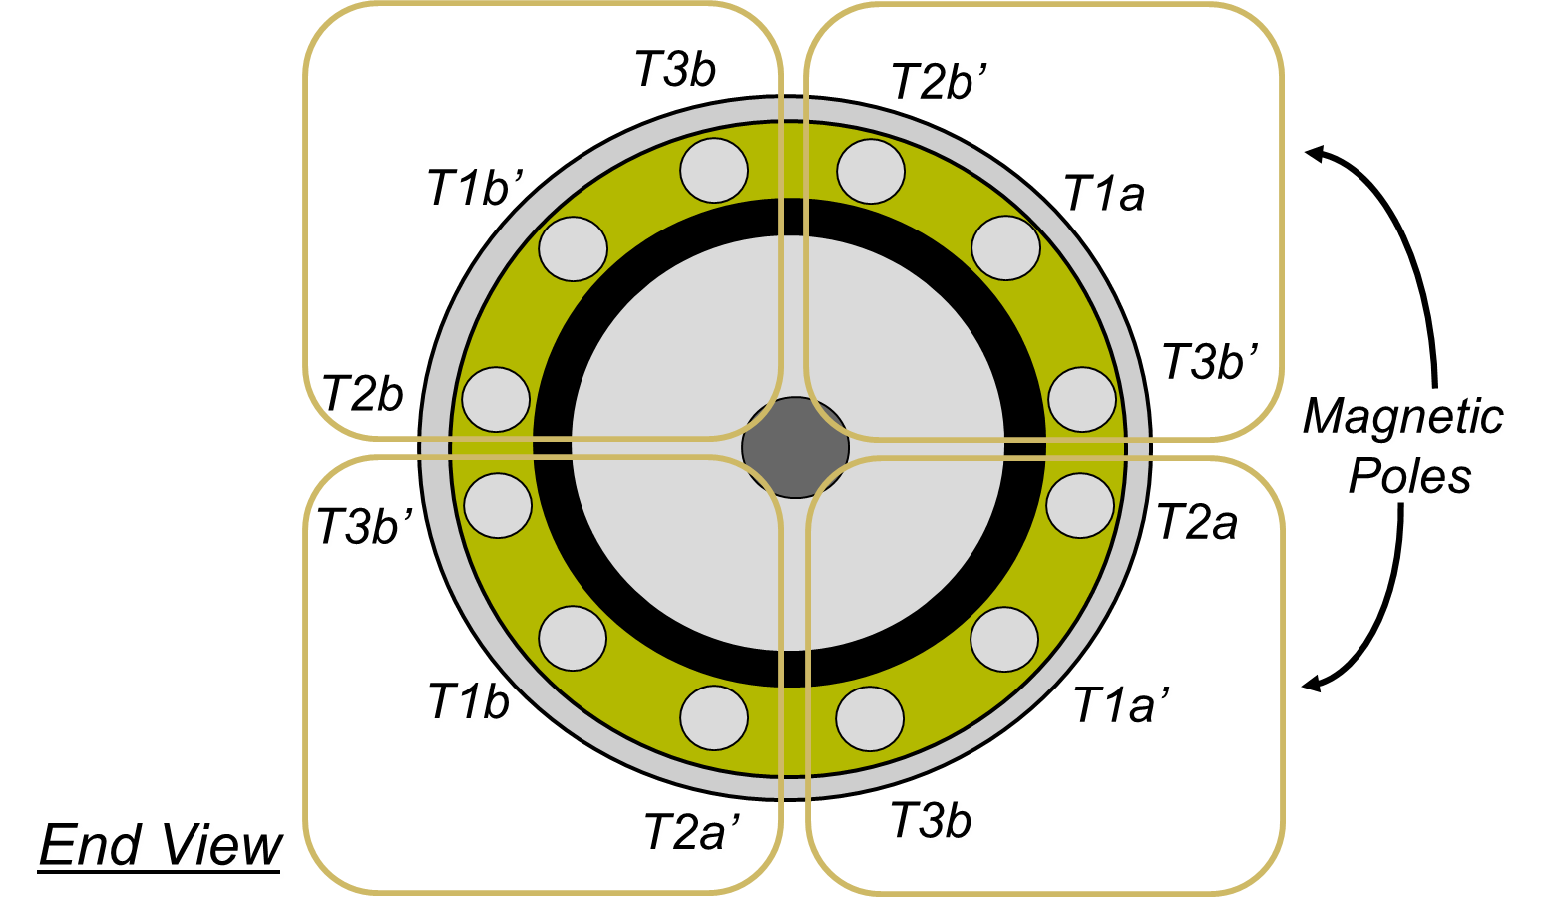
Three Phrase Motor Construction

Slide 15
What is slip?
To produce torque in an induction motor, currentmust flow in the rotor.
To induce current flow in the rotor, the rotorspeed must be slightly slower than thesynchronous speed.
The difference between the synchronous speedand the rotor speed (rated speed) is called the slip.
FLUX
STATOR
SLIP
Rotor

Slide 16
Motor Rated Speed
(1-s)
Where:
N: RPM of the Motor
f: Frequency in Hz
P: Number of Poles of the motor
s: (No-N)/No

Slide 17
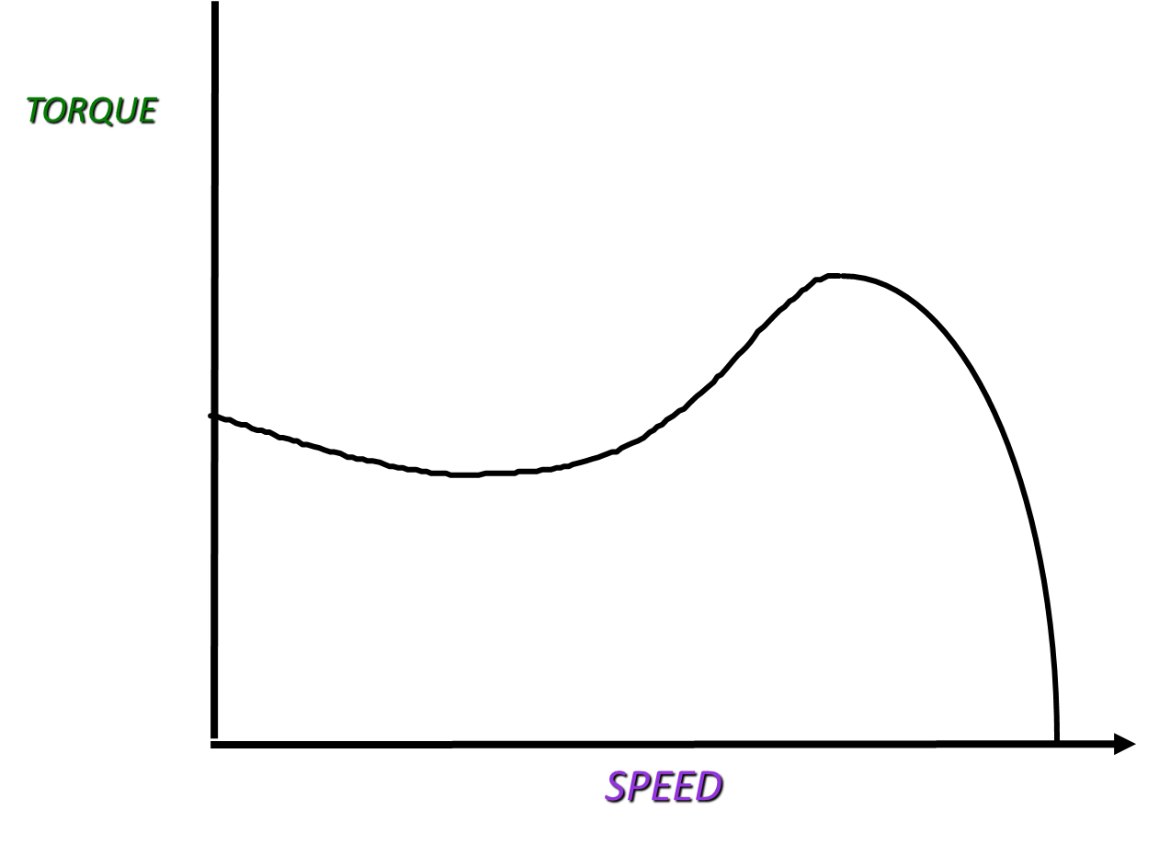
Torque
Curve

Slide 18
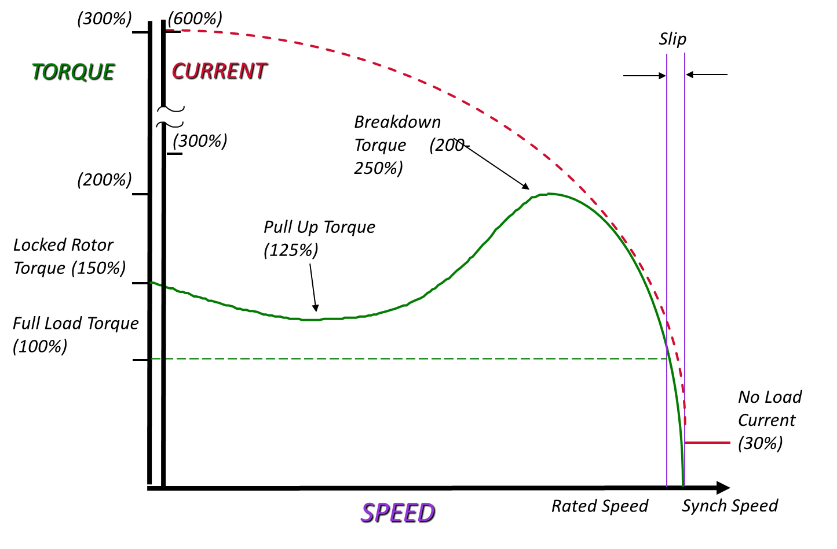
Torque Curve

Slide 19
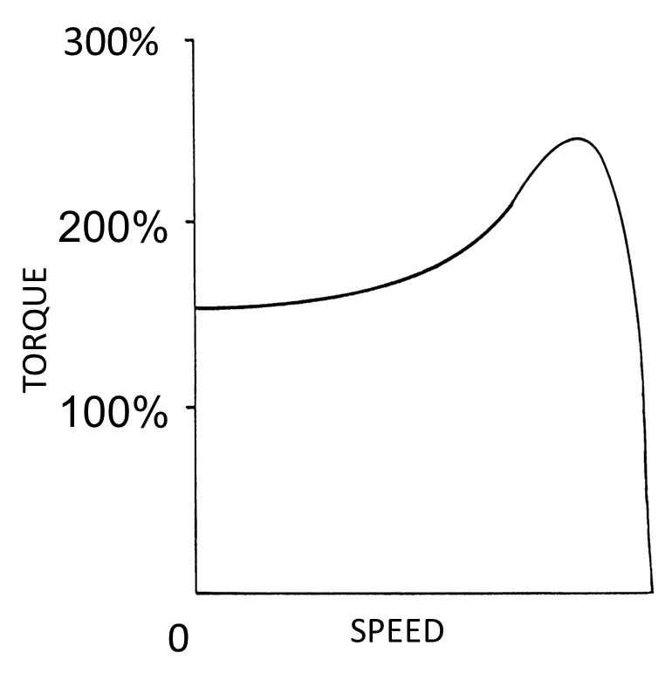
Nema Design Characteristics
NEMA Design A
High breakdown torque
Normal Starting Torque
High Starting current
Low Full load slip
Used in applications that require
Occasional Overloads
Better Efficiency

Slide 20
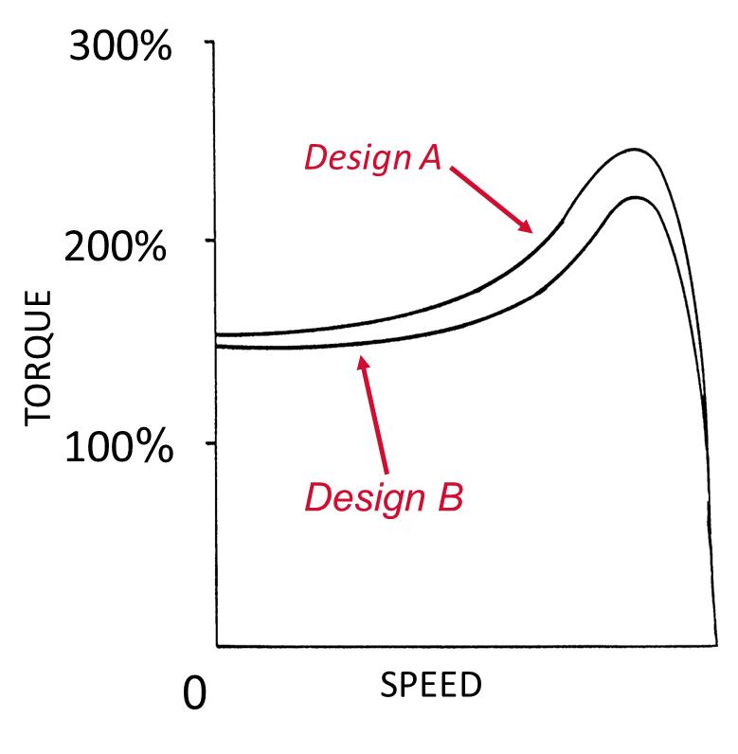
Nema Design Characteristics
NEMA Design B
Normal breakdown torque
Normal Starting Torque
Low Starting current
Normal Full load slip
Less than 5%
General Purpose Motor

Slide 21
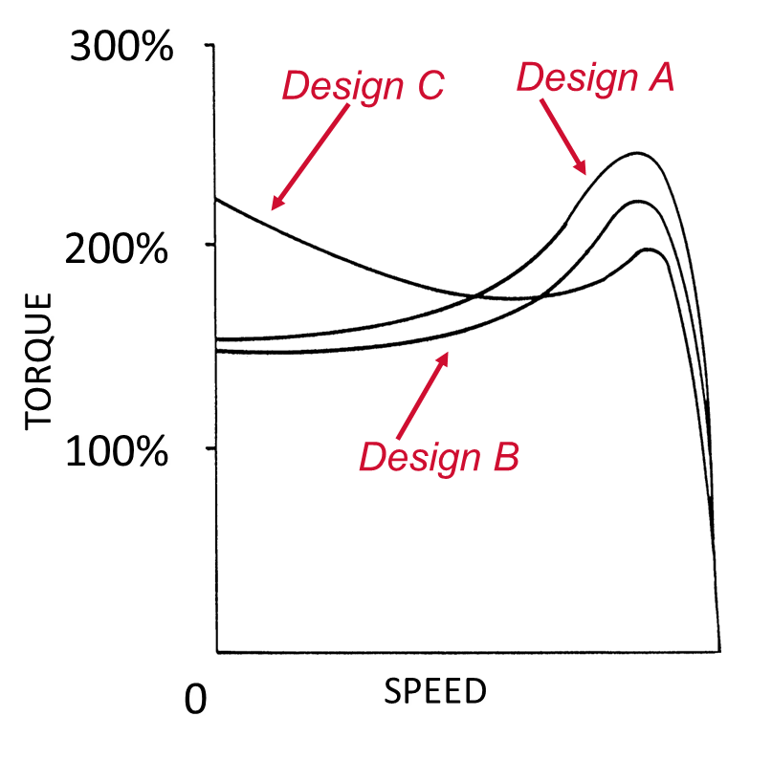
Nema Design Characteristics
NEMA Design C
Low breakdown torque
High Starting Torque
Low Starting current
Normal Full load slip
Less than 5%
Used in applications that require
High Breakaway Torque

Slide 22
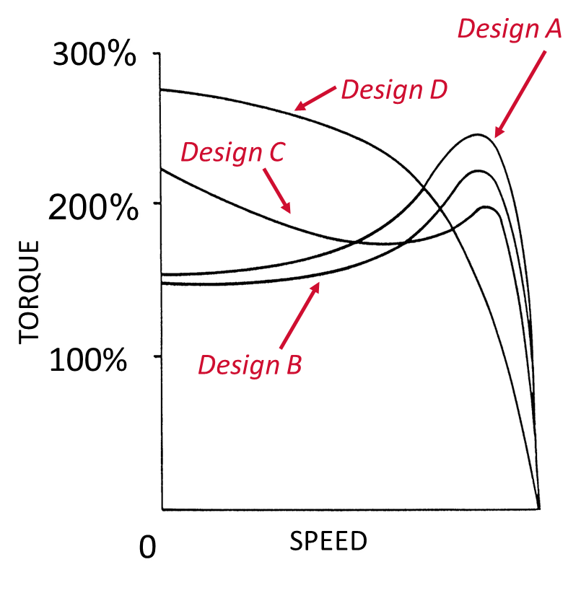
Nema Design Characteristics
NEMA Design D
High breakdown torque
High Starting Torque
Normal Starting current
HIgh Full load slip
5-13%
Used in applications that require
High Breakaway Torque

Slide 23
Rotational Horsepower Formula
HP = Torque x RPM
5250
OR
Torque = HP x 5250
RPM
Where:
Torque - Amount of torque in lb. ft.
RPM - RPM of the motor
5250 - Constant obtained by dividing 33,000 by 6.28

Slide 24
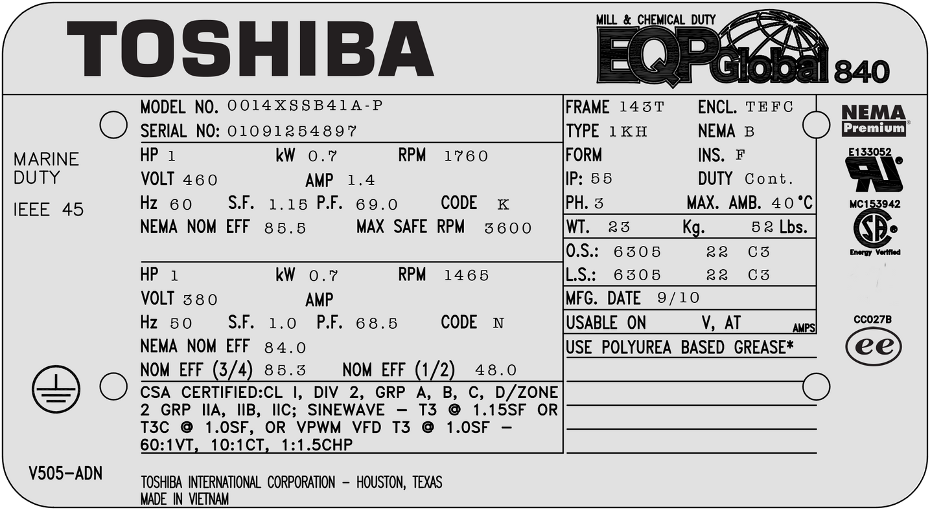
Motor Nameplate Data

Slide 25
Understanding the Nameplate
HP- Horsepower
The horsepower figure stamped on the nameplate is the horsepower the motor is rated to develop when connected to a circuit of the voltage, frequency and number of phases specified on the motor nameplate.

Slide 26
Understanding the Nameplate
Revolutions per Minute
The RPM value represents the approximate speed at which the motor will run when properly connected and delivering its rated output.

Slide 27
Understanding the Nameplate
Poles
Synchronous RPM
Typical Nameplate RPM
2
3600
3450
4
1800
1725
6
1200
1140
8
900
850

Slide 28
Understanding the Nameplate
Voltage
The rated voltage figure on the motor nameplate refers to the voltage of the supply circuit to which the motor should be connected, to produce rated horsepower and RPM.

Slide 29
Understanding the Nameplate
Amps
The amp figure on the motor nameplate represents the approximate current draw by the motor when developing rated horsepower on a circuit of the voltage and frequency specified on the nameplate.

Slide 30
Understanding the Nameplate
NEMA Design
The NEMA Design rating specifies the speed torque curve that will be produced by the motor.

Slide 31
Understanding the Nameplate
Insulation Class
Insulation Class letter designates the amount of allowable temperature rise bsaed on the insulation system and the motor service factor.

Slide 32
Insulation Class Information
Insulation Class
Ambient Temp.
Temp. Rise
Total Temp.
A
40 C
65 C
105 C
B
40 C
90 C
130 C
F
40 C
115 C
155 C
H
40 C
140 C
180 C
*Most common insulation classes are class B & F

Slide 33
Understanding the Nameplate
S.F. - Service Factor
The number by which the horsepower rating is multiplied to determine the maximum safe load that a motor may be expected to carry continuously.
Example: A 10 HP Motor with a service factor of 1.15 deliver 11.5 horsepower continuously without exceeding the allowabe temperature rise of the insulation class.

Slide 34
Understanding the Nameplate
Frame
The frame designation refers to the physical size of the motor as well as certain construction features such as the shaft and mounting dimensions.

Slide 35
NEMA
Frame Chart

Slide 36
Common
types of
Motor
Enclosure
Open Drip-proof (ODP)
Totally Enclosed non-ventilated (TENV)
Totally enclosed fan cooled (TEFC)
Totally Enclosed blower code (TEBC)

Slide 37
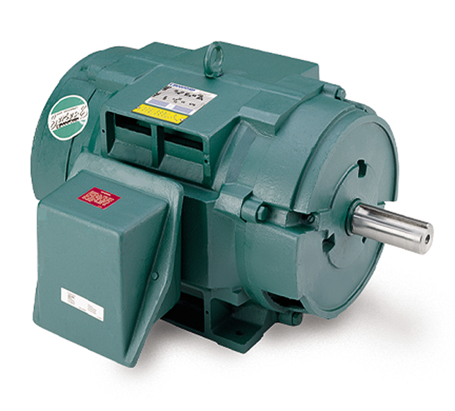
Types of Motor Enclosures
ODP
Open drip-proof
Ventilating openings permit passage of external cooling air over and around the windings of the motor. Small degree of protection against lquid or solid particles entering the enclosure.

Slide 38
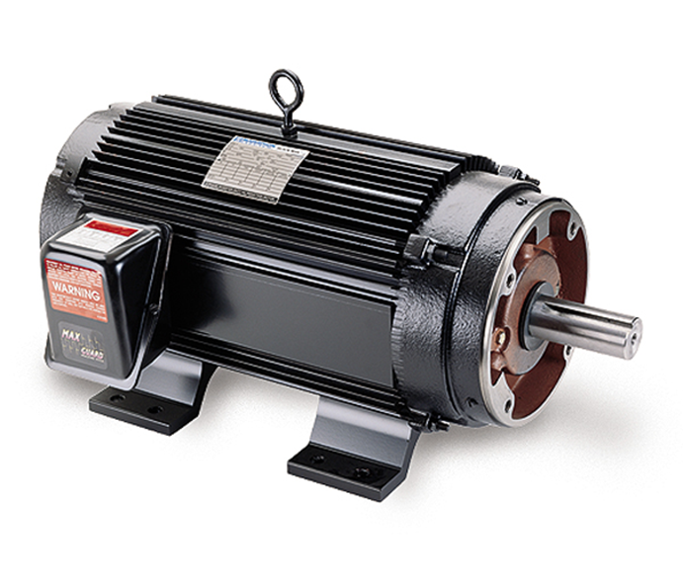
Types of Motor Enclosures
TENV
Totally enclosed non ventilated
Totally enclosed enclosure with no means of external cooling.

Slide 39
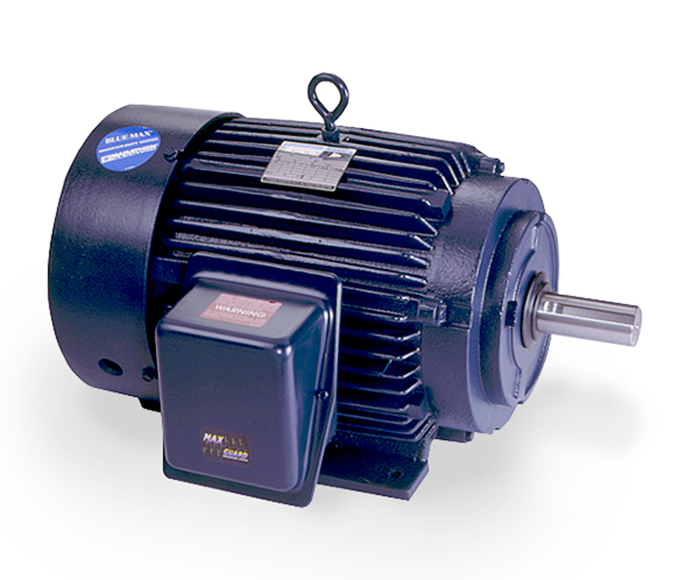
Types of Motor Enclosures
TEFC
Totally enclosed fan-cooled
Totally enclosed enclosure with external cooling means, such as a shaft connected fan

Slide 40
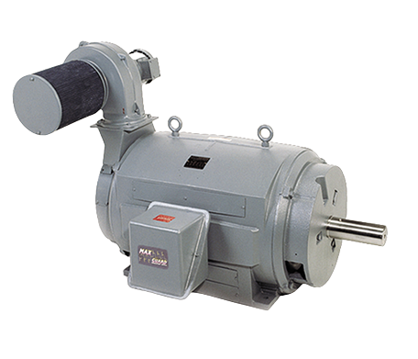
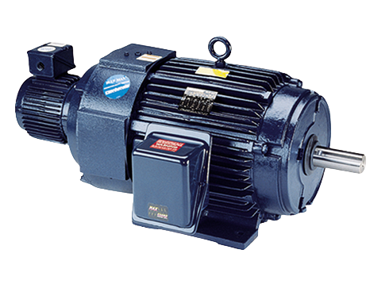
Types of Motor Enclosures
TEBC
Totally enclosed blower-cooled
Totally enclosed enclosure with external cooling means such as a separately controlled motor power.

Slide 41
Application
Driven
Enclosures
Washdown
Stainless Steel
Explosion Proof
Totally Enclosed Air Over
Weather Protected
Type I
Type II

Slide 42
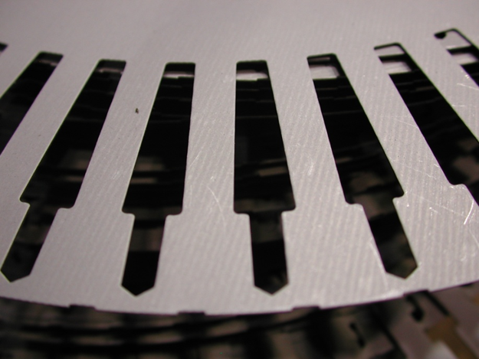
Something you cannot see...
Stator & Rotor Laminations
C5 or C3 Lamination Steel
C5 rated for 1000 degrees F
C3 rated for 750 degrees F

Slide 43
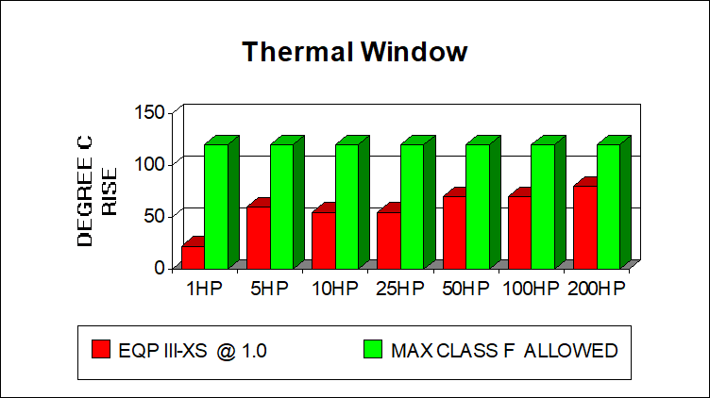
How does everything add up?

Slide 44
Questions?

